Slide 1

SPITRACK
Simplifying Research Techniques

Slide 2

Team Members - Eccentrics
Mohammad Nabiluzzaman Neloy 1831251042 mohammad.nabiluzzaman@northsouth.edu
Rafid Ahmed 1831395642 rafid.ahmed@northsouth.edu

Slide 3
Organization

Slide 4
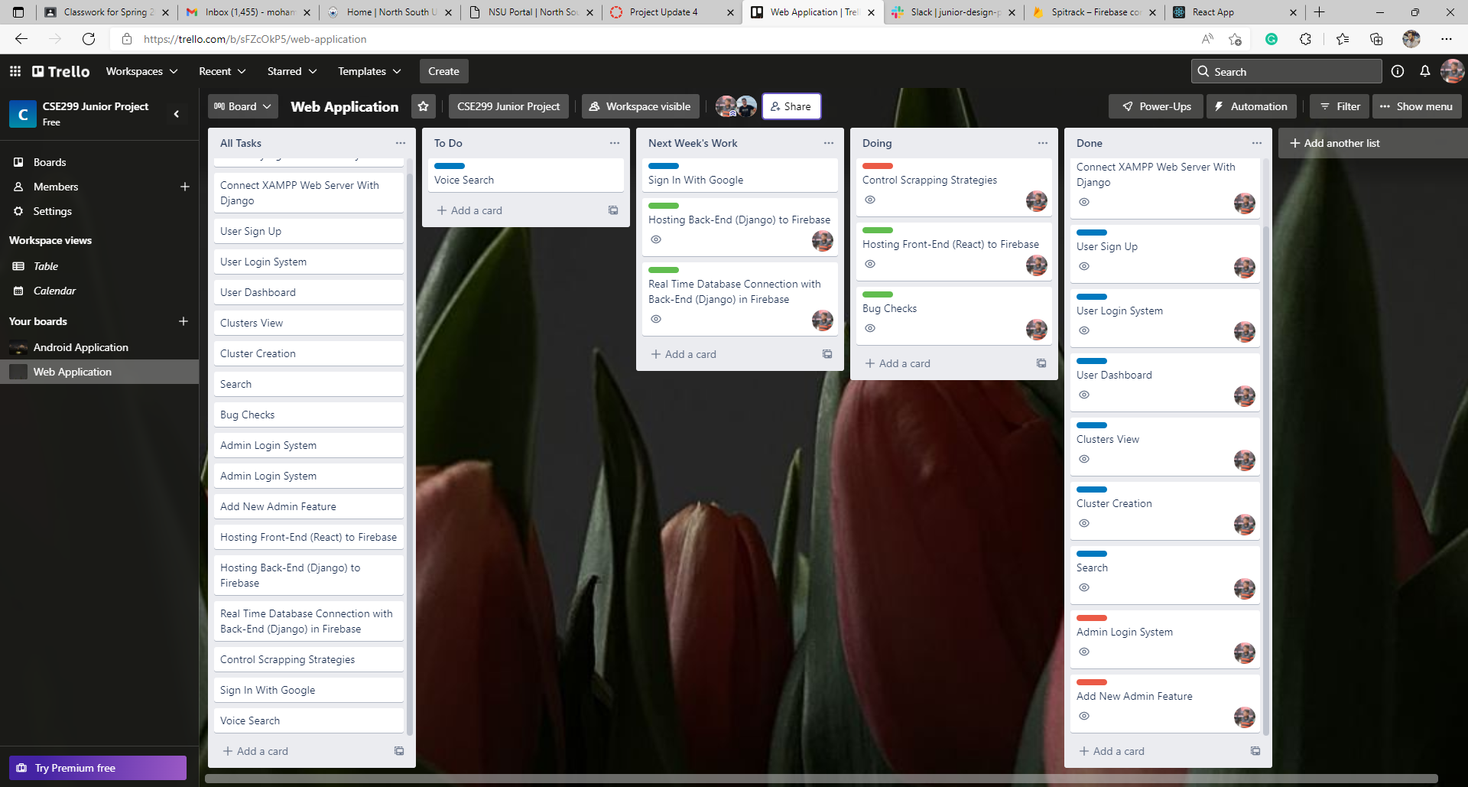
Web Application (Neloy): Trello Board

Slide 5
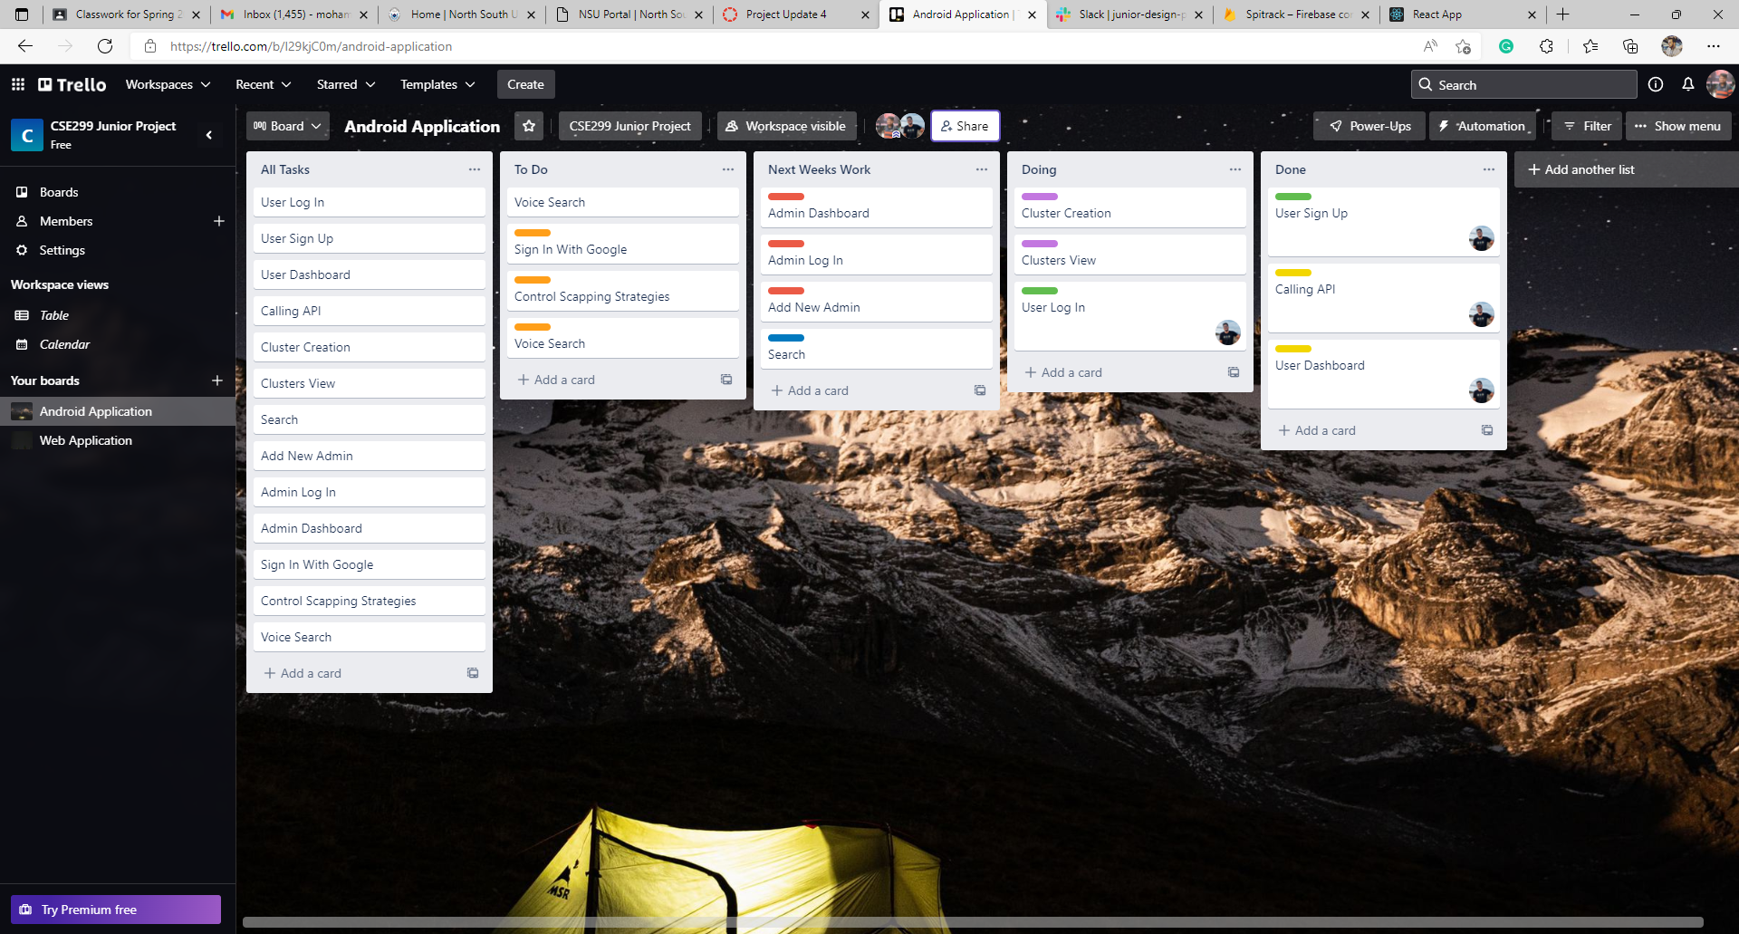
Android Application (Rafid): Trello Board

Slide 6
Communication

Slide 7
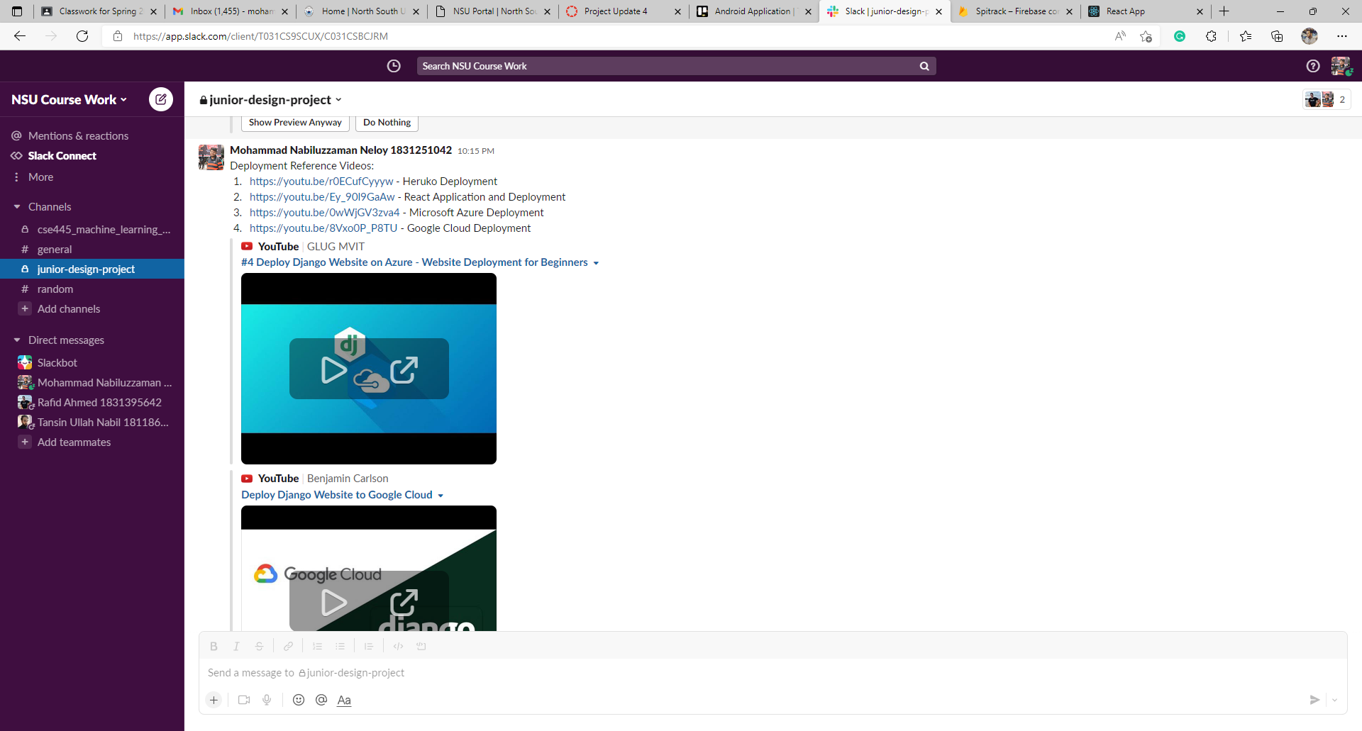

Slide 8
Work – WebApp (Neloy)

Slide 9
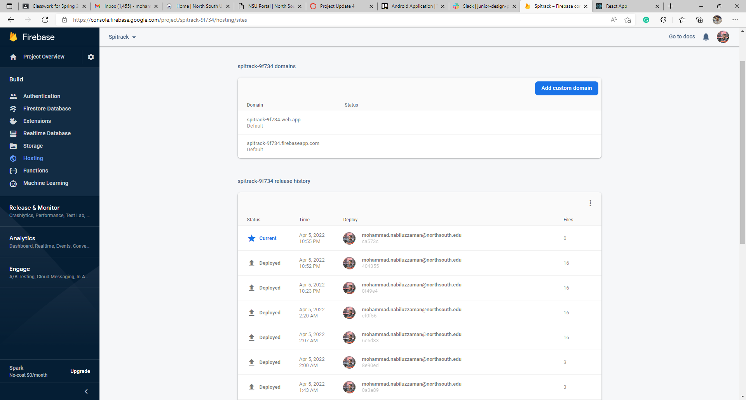
Web Application (Neloy): Hosting Front-End (React) to Firebase
Random Domain (Free)
Deployment Records

Slide 10
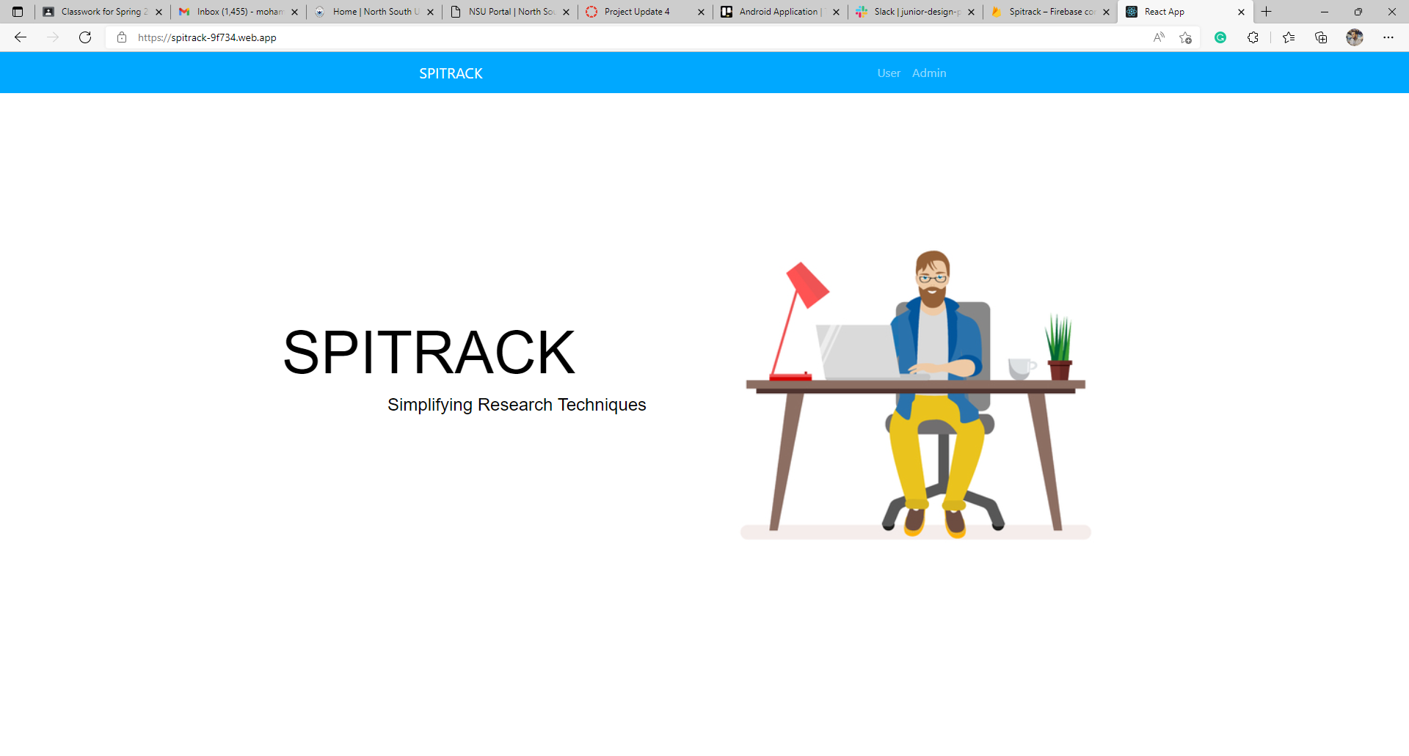
Web Application (Neloy): Live Page After Hosting (Landing Page)
Random Firebase Domain

Slide 11
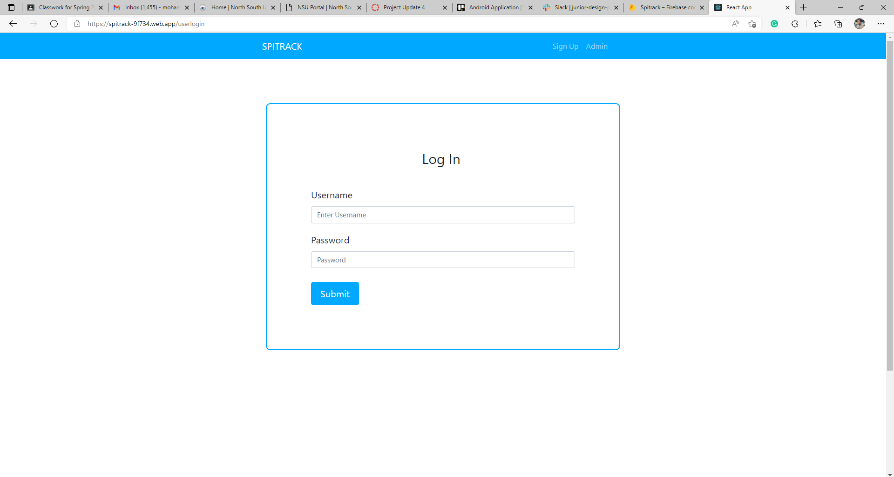
Web Application (Neloy): Live Page After Hosting (User Log In)
Random Firebase Domain

Slide 12
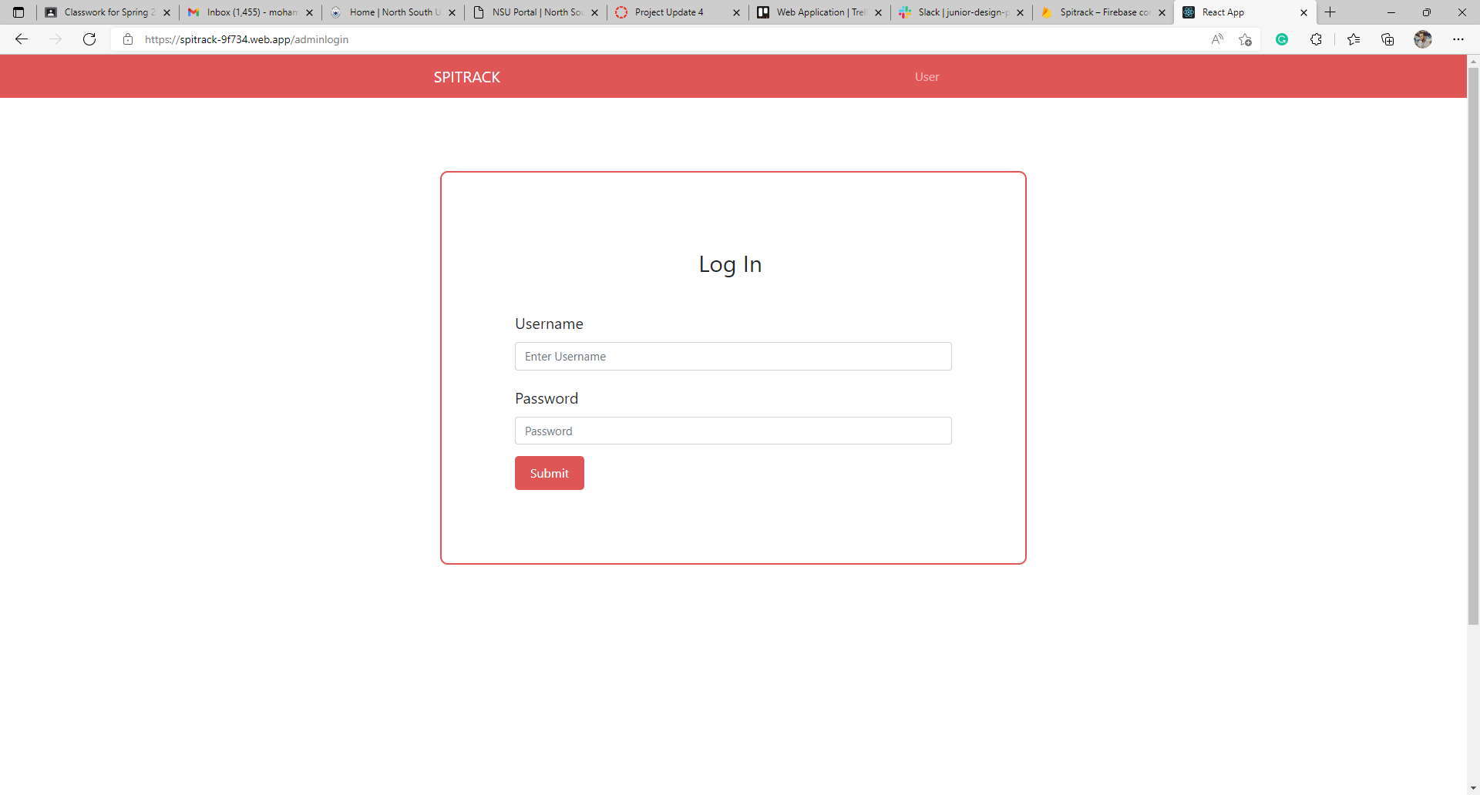
Web Application (Neloy): Live Page After Hosting (Admin Login)
Random Firebase Domain

Slide 13
Work – Android App (Rafid)

Slide 14
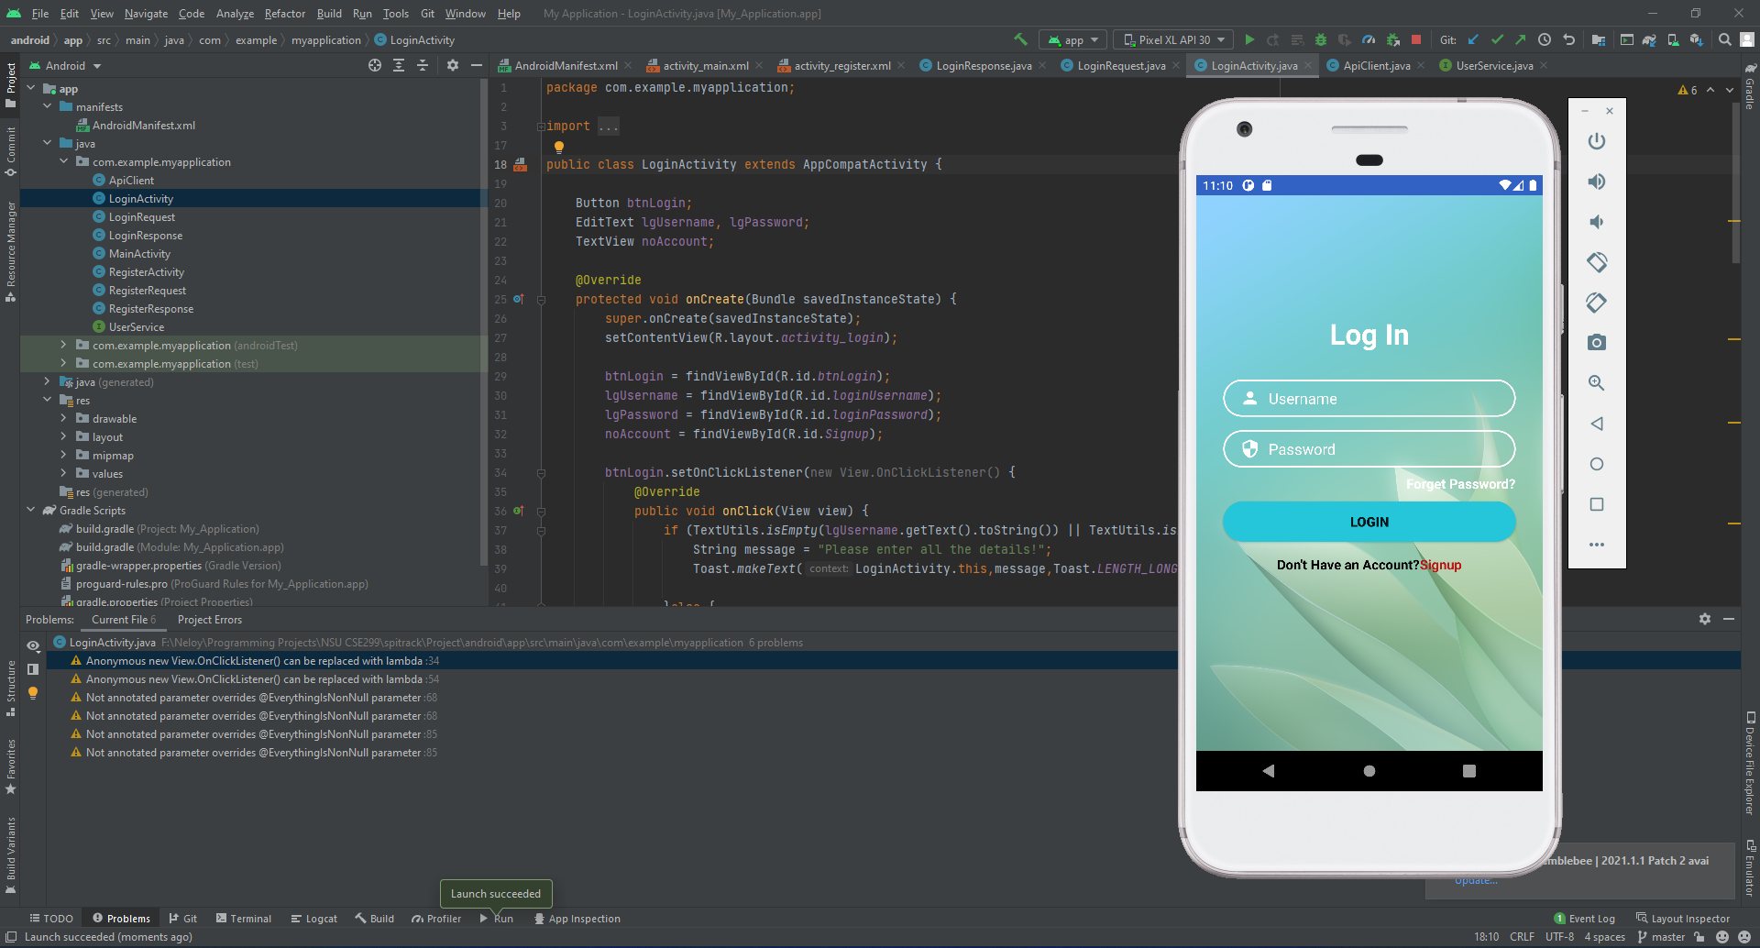
Android Application (Rafid): Login Activity

Slide 15
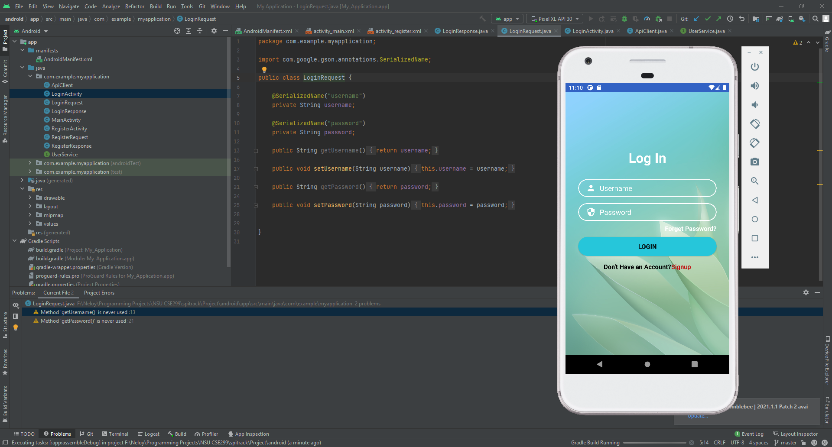
Android Application (Rafid): Login Request
Username

Slide 16
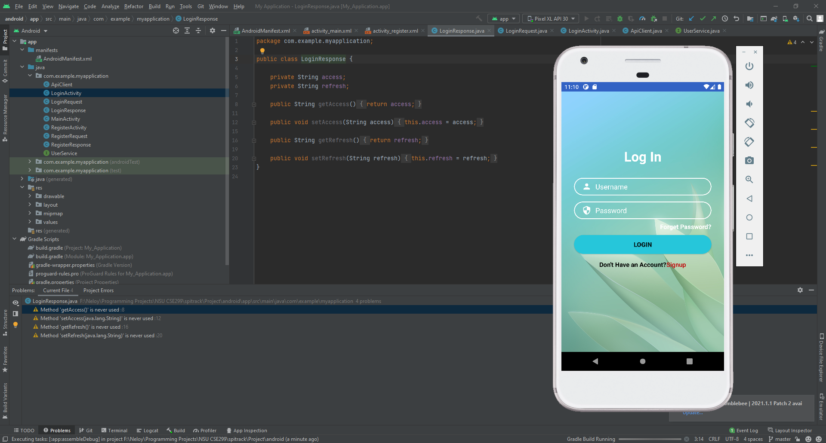
Android Application (Rafid): Login Response

Slide 17
Thank You!

